Slide 1
Modelling direction detection in selected stocks in Indian BFSI sector
REVA Academy for Corporate Excellence (RACE)
Anand Mohan
SRN: R19MBA53
Date: 10/10/2022
MBA in Business Analytics
Capstone Project Presentation
Year: II
race.reva.edu.in

Slide 2
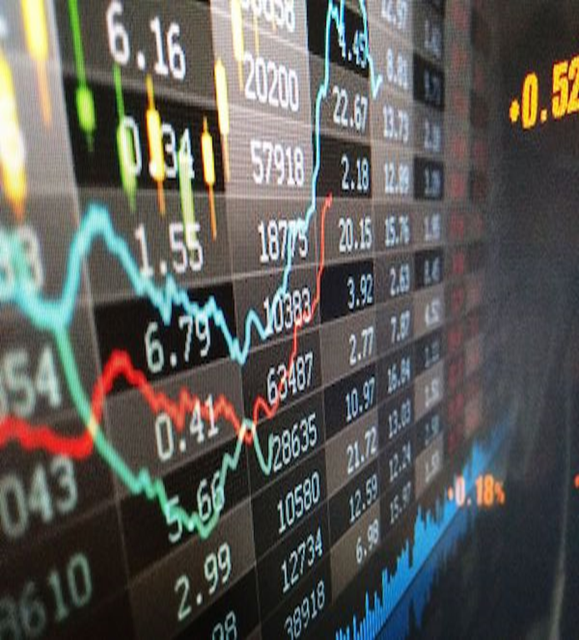
Introduction
Background | Current status | Why this study
Algorithmic Trading
Back testing
Stock Market-high volatility-New field for Researchers!
ML, AML, Deep Learning Algorithms .
Higher Accuracy.
Minimize Errors.
ML Algorithms rank on relative expected outcome.

Slide 3
Literature Review
Paper Title | Authors | Journal | Objective | Research Gap (if any)
Stock Market Price Prediction and Analysis | Rajkar, Ajinkya, Aayush, Aniket | Inter national Journal of Engineering Research & Technology | Predict Stock market Returns using ML | Feature expansion and elimination techniques in data preparation lacking details
Analysis and Evaluation of Technical Indicators for Prediction of Stock Market | Thanekar, Gananjay Sandeep Zaheed Shamsuddin | International Journal of Engineering Research & Technology (IJERT) | Utilize Technical Indicator for higher SM Returns | Fundamental analysis should also be explored.
Effects of Volatility and Trend Indicator for Improving Price Prediction of Cryptocurrency | Dahham, Ibrahim, Abdullahi | IOP Conference Series: Materials Science and Engineering | Volatility and Trend Indicator for Predicting ret from Cryptocurrency. | Volume and momentum indicators also should be explored.

Slide 4

Problem Statement
Business Problem | Analytics Solution
Easy, and simple Modelling techniques
Minimize losses
Fundamental Analysis-
Long Term Investments
Technical Analysis-trends in the stock's price, momentum, and volume
Algorithmic trading
Volatility Still Unpredictable

Slide 5

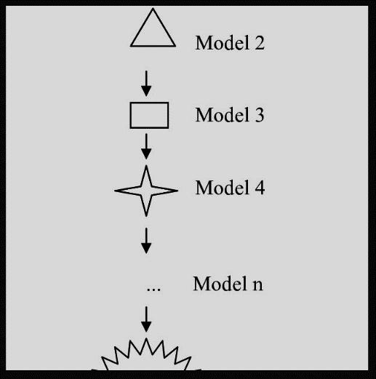
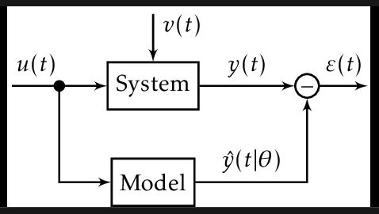
Project Objectives
EDA
Hypothesis Testing
Feature Addition
Get Right Stock
Collect Relevant data
Minimize prediction errors.
standard Error Metrics
Precision, recall,f1-score,
accuracy score, ROC AUC Score
Logistic Regression
Decision Tree
Random Forest
k-Nearest Neighbours
Extreme Gradient Boosting

Slide 6
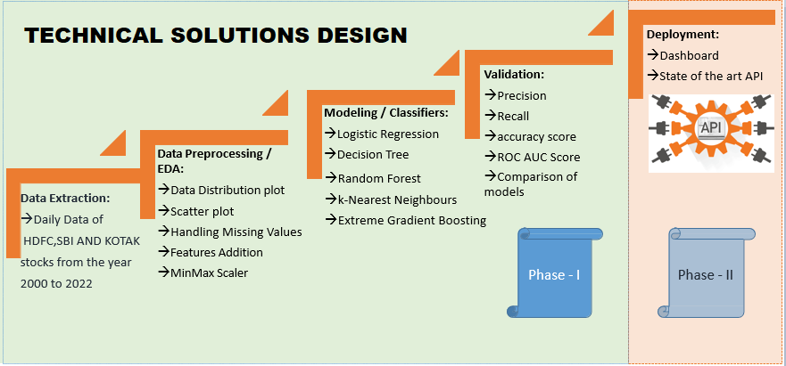
Project Methodology

Slide 7
Business Understanding
Stocks Technical Analysis
Stocks Fundamental Analysis
Technical Indicators | HDFC | KOTAK | SBI
RSI | 58.72 | 60.33 | 69.86
MACD | 18.97 | 25.42 | 14.07
Stochastic | 89.62 | 76.32 | 95.02
ADX | 11.43 | 37.66 | 30.53
ADX Upper Band | 1514.69 | 1970.16 | 582.40
ADX Lower Band | 1261.46 close price of HDFC stock is 1493.05 | 1854.60 close price of KOTAK stock is 1944.20 | 505.09 close price of SBI stock is 575.05
Particulars | HDFC | KOTAK | SBI
Promoters | 25.73% | 25.97% | 57.57%
Investors | 74.27% | 74.03% | 42.43%
Net Profit (Profit and Loss) | 36,961.36 | 8572.69 | 31,675.98
Adjusted EPS | 66.65 | 42.99 | 35.49
Total Liabilities (Balance Sheet) | 20.68, 535.05 | 4,29, 428.40 | 49,87, 597.41
Total Assets (Balance sheet) | 20,68, 535.05 | 4,29, 428.40 | 49,87, 597.41
Closing Cash (cashflow) | 155,386 | 52,665 | 398,905
All figures are in crores for the year 2022.

Slide 8
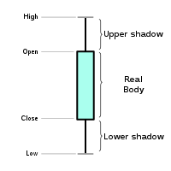
Data Understanding
Symbol | series | Prev Close | Open | High | Low | Last price | Close | VWAP | Vol
HDFC | EQ | 293.5 | 317 | 317 | 297 | 304 | 304.1 | 303.62 | 255251
HDFC | EQ | 304.05 | 290 | 303.9 | 285 | 295 | 292.8 | 294.53 | 269087
KOTAK | EQ | 229.35 | 247.7 | 247.7 | 225 | 247 | 246.9 | 244.12 | 73681
KOTAK | EQ | 246.95 | 229 | 240 | 227 | 228 | 228.4 | 233.75 | 105799
SBI | EQ | 243.65 | 243.6 | 262 | 238 | 258 | 259.1 | 251.46 | 4495 741
SBI | EQ | 259.1 | 249 | 264 | 245 | 249 | 248.5 | 252.35 | 3434 058
The previous close nearly always refers to the previous day's final price.
The last price is the one at which the foremost recent transaction happens.
volume-weighted average worth (VWAP) represents the typical price listed throughout the day,
based on both volume and worth.
Volume and Share turnover is an estimation of stock liquidity.

Slide 9

Data Preparation
Missing Values | Feature Engineering
'Trades', 'Deliverable Volume', and'% Deliverable' had more than 100 missing values. Hence, those columns were dropped. | Newly Added Feature Variables: 13 days,20 days,100 days, 200 days Simple moving averages. exponential moving averages for 7 days,13 days,20 days,100 days, and 200 days. 1 day's previous lag values of volume. 6,10,14 and 30 days consecutive closing prices are tabulated week on week for the entire dataset . Momentum indicators Trend indicators Volatility indicators Volume indicators
MinMax Scaler shrinks the data inside the given range in this project i.e. from zero to one. It scales the price to a selected value range while not varying the form of the initial distribution.

Slide 10
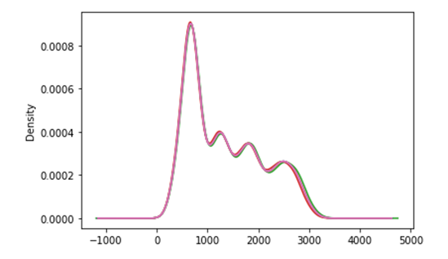
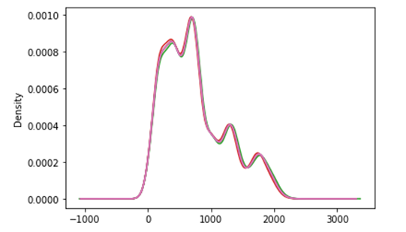
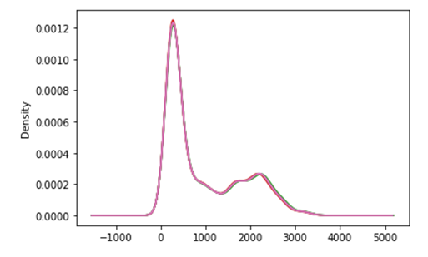
Descriptive Analytics
Data Distribution plot of Feature variables and Close price for HDFC Stock shows Data has positive skewed distribution.
Data Distribution plot of Feature variables and Close price for KOTAK Stock shows Data has positive skewed distribution.
Data Distribution plot of Feature variables and Close price for SBI Stock shows Data has positive skewed distribution.

Slide 11
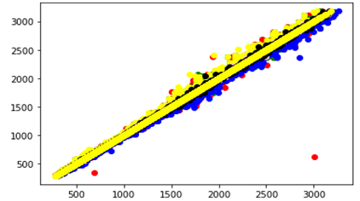
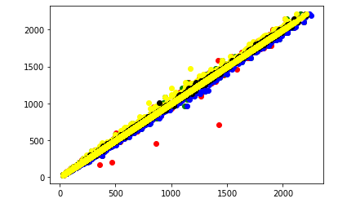
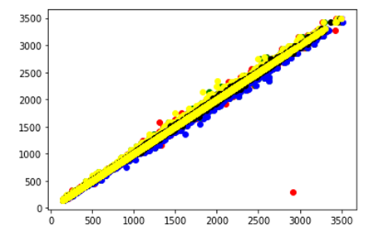
Descriptive Analytics
Scatter plot of Feature variables and Close price for HDFC Stock
Scatter plot of Feature variables and Close price for KOTAK Stock
Scatter plot of Feature variables and Close price for SBI Stock

Slide 12




Modeling
Modeling Techniques | Modeling Process | Model Building
Feature Engineering CLOSE PRICE
Direction Detection by 6,10,14 days consecutive closing prices split
week on week.
Go Long Direction Prediction is performed using Momentum Indicators as Feature Variables on 0.5% percentage change of the closing price.
Similar process is repeated for other Technical Indicators namely
Trend Indicators, volatility Indicators and Volume Indicators.
if the percentage change of the closing price is more than 0.5%, the direction of the closing price is treated as positive, and suitable for long Trading in the stock market.
The Classification Models used are Logistic Regression, K Nearest Neighbours, XG Boost, Decision Tree using Grid SearchCV and Cross Validation and Random Forest using Randomized SearchCV and Cross Validation.

Slide 13
Model Evaluation using LR Classifier
 | HDFC | KOTAK | SBI
Direction Detection by 6,10,14 days consecutive closing prices split week on the week | precision-0.35 recall-0.60 accuracy-0.35 | Precision-0.37 recall-0.74 accuracy-0.36 | Precision-0.36 recall-1.00 accuracy-0.36
Go Long Direction Prediction using Volume Indicators | precision-0.98 recall-0.83 accuracy-0.92 | precision-0.99 recall-0.93 accuracy-0.97 | precision-0.92 recall-0.80 accuracy-0.90
Go Long Direction Prediction using Momentum Indicators | precision-0.71 recall-0.63 Accuracy-0.76 | precision-0.73 recall-0.61 accuracy-0.75 | precision-0.69 recall-0.62 accuracy-0.74
Go Long Direction Prediction using Trend Indicators | precision-0.83 recall-0.59 Accuracy-0.80 | precision-0.76 recall-0.48 accuracy-0.72 | precision-0.78 recall-0.49 accuracy-0.74
Go Long Direction Prediction using Volatility Indicators | precision-0.93 recall-0.47 Accuracy-0.77 | precision-0.90 recall-0.40 accuracy-0.74 | precision-0.81 recall-0.30 accuracy-0.70

Slide 14
Model Evaluation using RF Classifier
 | HDFC | KOTAK | SBI
Direction Detection by 6,10,14 days consecutive closing prices split week on the week | precision-0.85 recall-0.89 accuracy-0.87 | Precision-0.71 recall-0.79 accuracy-0.74 | Precision-0.83 recall-0.88 accuracy-0.85
Go Long Direction Prediction using Volume Indicators | precision-0.93 recall-0.69 accuracy-0.85 | precision-0.92 recall-0.79 accuracy-0.89 | precision-0.90 recall-0.73 accuracy-0.86
Go Long Direction Prediction using Momentum Indicators | precision-0.76 recall-0.51 Accuracy-0.75 | precision-0.78 recall-0.50 accuracy-0.75 | precision-0.72 recall-0.55 accuracy-0.74
Go Long Direction Prediction using Trend Indicators | precision-0.87 recall-0.56 Accuracy-0.80 | precision-0.85 recall-0.44 accuracy-0.74 | precision-0.83 recall-0.57 accuracy-0.78
Go Long Direction Prediction using Trend Indicators | precision-0.92 recall-0.53 Accuracy-0.79 | precision-0.89 recall-0.50 accuracy-0.78 | precision-0.83 recall-0.61 accuracy-0.80

Slide 15
Model Evaluation using XG Boost Classifier
 | HDFC | KOTAK | SBI
Direction Detection by 6,10,14 days consecutive closing prices split week on the week | precision-0.35 recall-0.42 accuracy-0.40 | Precision-0.38 recall-0.41 accuracy-0.40 | Precision-0.38 recall-0.47 accuracy-0.37
Go Long Direction Prediction using Volume Indicators | precision-0.90 recall-0.73 accuracy-0.86 | precision-0.92 recall-0.87 accuracy-0.92 | precision-0.88 recall-0.82 accuracy-0.89
Go Long Direction Prediction using Momentum Indicators | precision-0.70 recall-0.61 Accuracy-0.75 | precision-0.74 recall-0.59 accuracy-0.75 | precision-0.70 recall-0.59 accuracy-0.74
Go Long Direction Prediction using Trend Indicators | precision-0.85 recall-0.65 Accuracy-0.82 | precision-0.82 recall-0.61 accuracy-0.79 | precision-0.83 recall-0.67 accuracy-0.81
Go Long Direction Prediction using Trend Indicators | precision-0.84 recall-0.69 Accuracy-0.82 | precision-0.81 recall-0.63 accuracy-0.79 | precision-0.80 recall-0.67 accuracy-0.81

Slide 16
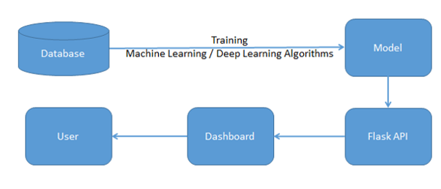
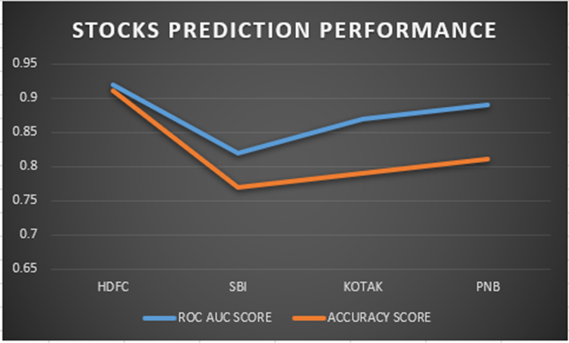
Model Deployment
Demonstration
As per the proposal for future assignments, the dashboard takes API as an input Derived from the machine/deep learning algorithms for multi-label features with an end-to-end UI Interface.

Slide 17
Results and Insights
Key Findings | Suggestions
 | HDFC | KOTAK | SBI
Direction Detection by 6,10,14 days consecutive closing prices split week on the week (RF Classifier ) | precision-0.85 recall-0.89 accuracy-0.87 | Precision-0.71 recall-0.79 accuracy-0.74 | Precision-0.83 recall-0.88 accuracy-0.85
Go Long Direction Prediction using Volume Indicators (LR Classifier ) | precision-0.98 recall-0.83 accuracy-0.92 | precision-0.99 recall-0.93 accuracy-0.97 | precision-0.92 recall-0.80 accuracy-0.90
Go Long Direction Prediction using Momentum Indicators (LR Classifier ) | precision-0.71 recall-0.63 Accuracy-0.76 | precision-0.73 recall-0.61 accuracy-0.75 | precision-0.69 recall-0.62 accuracy-0.74
Go Long Direction Prediction using Trend Indicators (XG Boost Classifier ) | precision-0.85 recall-0.65 Accuracy-0.82 | precision-0.82 recall-0.61 accuracy-0.79 | precision-0.83 recall-0.67 accuracy-0.81
Go Long Direction Prediction using Trend Indicators (XG Boost Classifier ) | precision-0.84 recall-0.69 Accuracy-0.82 | precision-0.81 recall-0.63 accuracy-0.79 | precision-0.80 recall-0.67 accuracy-0.81
RECOMMENDATION FROM BUSINESS PERSPECTIVE:
For a stop loss of 2.0 reward to risk ratio for 0.8 Precision would be 2*.8/2*.2=4:1 if 0.5% difference in consecutive day close price for HDFC stock is only 2.0.for higher percentage difference reward to risk ratio would be higher.

Slide 18
Results and Insights
Key Findings | Suggestions
 | HDFC
Direction Detection by 6,10,14 days consecutive closing prices split week on the week (RF Classifier ) | precision-0.85 recall-0.89 accuracy-0.87
Go Long Direction Prediction using Volume Indicators (LR Classifier ) | precision-0.98 recall-0.83 accuracy-0.92
Go Long Direction Prediction using Momentum Indicators (LR Classifier ) | precision-0.71 recall-0.63 Accuracy-0.76
Go Long Direction Prediction using Trend Indicators (XG Boost Classifier ) | precision-0.85 recall-0.65 Accuracy-0.82
Go Long Direction Prediction using Trend Indicators (XG Boost Classifier ) | precision-0.84 recall-0.69 Accuracy-0.82

Slide 19

Conclusion and Future Work
Any stock on the stock market can utilize the same procedure as defined in this project to forecast buy or sell choices, which is helpful.
Intelligent Automated system on Options Trading would be the next step forward.
In the Future, there is a deployment Dashboard proposed.
In future projects, it can be shown how to define Bullish and Bearish regimes using modern machine learning techniques.
The Sentiment Analysis Approach may also be explored using Text Analytics for predicting stock market returns.

Slide 20
References
Bibliography | Webliography
Al-Bairmani, Z. A. A., & Ismael, A. A. (2021). Using Logistic Regression Model to Study the Most Important Factors Which Affects Diabetes for the Elderly in the City of Hilla / 2019. Journal of Physics: Conference Series, 1818(1). https://doi.org/10.1088/1742-6596/1818/1/012016
Alhomadi, A. (2021). Forecasting stock market prices : A machine learning approach. Digital Commons, 11(2), 16–36.
Anjani, T., & Syarif, A. D. (2019). The Effect of Fundamental Analysis on Stock Returns using Data Panels ; Evidence Pharmaceutical Companies listed on IDX. International Journal of Innovate Science and Research Technology, 4(7), 500–505.
Cornellius Yudha Wijaya. (2021). CRISP-DM Methodology For Your First Data Science Project. https://towardsdatascience.com/crisp-dm-methodology-for-your-first-data-science-project-769f35e0346c
Dahham, A. Z. D., & Ibrahim, A. A. (2020). Effects of Volatility and Trend Indicator for Improving Price Prediction of Cryptocurrency. IOP Conference Series: Materials Science and Engineering, 928(3). https://doi.org/10.1088/1757-899X/928/3/032043
Dar, A. N. (2021). PRINCIPAL COMPONENT ANALYSIS (PCA) (Using Eigen Decomposition). Gsj, 9(7), 240–252. www.globalscientificjournal.com
Elbialy, B. A. (2019). The Effect of Using Technical and Fundamental Analysis on the Effectiveness of Investment Decisions of Traders on the Egyptian Stock Exchange. International Journal of Applied Engineering Research, 14(24), 4492–4501. http://www.ripublication.com
Faijareon, C., & Sornil, O. (2019). Evolving and combining technical indicators to generate trading strategies. Journal of Physics: Conference Series, 1195(1). https://doi.org/10.1088/1742-6596/1195/1/012010
Hafeez, M. A., Rashid, M., Tariq, H., Abideen, Z. U., Alotaibi, S. S., & Sinky, M. H. (2021). Performance improvement of decision tree: A robust classifier using tabu search algorithm. Applied Sciences (Switzerland), 11(15). https://doi.org/10.3390/app11156728
Hansen, K. B. (2020). The virtue of simplicity: On machine learning models in algorithmic trading. Big Data and Society, 7(1). https://doi.org/10.1177/2053951720926558
Huang, Y., Capretz, L. F., & Ho, D. (2021). Machine Learning for Stock Prediction Based on Fundamental Analysis. 2021 IEEE Symposium Series on Computational Intelligence, SSCI
2021 - Proceedings. https://doi.org/10.1109/SSCI50451.2021.9660134
Jena, M., & Dehuri, S. (2020). Decision tree for classification and regression: A state-of-the art review. Informatica (Slovenia), 44(4), 405–420. https://doi.org/10.31449/INF.V44I4.3023
Kimbonguila, A., Matos, L., Petit, J., Scher, J., & Nzikou, J.-M. (2019). Effect of Physical Treatment on the Physicochemical, Rheological and Functional Properties of Yam Meal of the Cultivar “Ngumvu” From Dioscorea Alata L. of Congo. International Journal of Recent Scientific Research, 10, 30693–30695. https://doi.org/10.24327/IJRSR
Magner, N., Lavin, J. F., Valle, M., & Hardy, N. (2021). The predictive power of stock market’s expectations volatility: A financial synchronization phenomenon. PLoS ONE, 16(5 May), 1–21. https://doi.org/10.1371/journal.pone.0250846
Markoulidakis, I., Kopsiaftis, G., Rallis, I., & Georgoulas, I. (2021). Multi-Class Confusion Matrix Reduction method and its application on Net Promoter Score classification problem. ACM International Conference Proceeding Series, 412–419. https://doi.org/10.1145/3453892.3461323
Mohapatra, S., & Misra, A. K. (2020). Momentum returns: A portfolio-based empirical study to establish evidence, factors and profitability in Indian stock market. IIMB Management Review, 32(1), 75–84. https://doi.org/10.1016/j.iimb.2019.07.007
moneycontrol. (n.d.). HDFC Bank Ltd.TECHNICALS. https://www.moneycontrol.com/technical-analysis/hdfcbank/HDF01/weekly
Mukerji, P., Chung, C., Walsh, T., & Xiong, B. (2019). The Impact of Algorithmic Trading in a Simulated Asset Market. Journal of Risk and Financial Management, 12(2), 68. https://doi.org/10.3390/jrfm12020068
Omta, W. A., van Heesbeen, R. G., Shen, I., de Nobel, J., Robers, D., van der Velden, L. M., Medema, R. H., Siebes, A. P. J. M., Feelders, A. J., Brinkkemper, S., Klumperman, J. S., Spruit, M. R., Brinkhuis, M. J. S., & Egan, D. A. (2020). Combining Supervised and Unsupervised Machine Learning Methods for Phenotypic Functional Genomics Screening. SLAS Discovery, 25(6), 655–664. https://doi.org/10.1177/2472555220919345
Rajkar, A., Kumaria, A., Raut, A., & Kulkarni, N. (2021). Stock Market Price Prediction and Analysis. International Journal of Engineering Research & Technology, 10(06), 115–119.
Rouf, N., Malik, M. B., Arif, T., Sharma, S., Singh, S., Aich, S., & Kim, H. C. (2021). Stock
market prediction using machine learning techniques: A decade survey on methodologies, recent developments, and future directions. Electronics (Switzerland), 10(21). https://doi.org/10.3390/electronics10212717
Schonlau, M., & Zou, R. Y. (2020). The random forest algorithm for statistical learning. Stata Journal, 20(1), 3–29. https://doi.org/10.1177/1536867X20909688
Shah, D., Isah, H., & Zulkernine, F. (2019). Stock market analysis: A review and taxonomy of prediction techniques. International Journal of Financial Studies, 7(2). https://doi.org/10.3390/ijfs7020026
Silva, I., & Naranjo, J. E. (2020). A systematic methodology to evaluate prediction models for driving style classification. Sensors (Switzerland), 20(6), 1–21. https://doi.org/10.3390/s20061692
Sonkiya, P., Bajpai, V., & Bansal, A. (2021). Stock price prediction using BERT and GAN. http://arxiv.org/abs/2107.09055
Thanekar, G. S., & Shaikh, Z. S. (2021). Analysis and Evaluation of Technical Indicators for Prediction of Stock Market. International Journal of Engineering Research & Technology (IJERT), 10(May), 341–344.
Wang, L. (2019). Research and Implementation of Machine Learning Classifier Based on KNN. IOP Conference Series: Materials Science and Engineering, 677(5), 0–5. https://doi.org/10.1088/1757-899X/677/5/052038
Zhang, P., Jia, Y., & Shang, Y. (2022). Research and application of XGBoost in imbalanced data. International Journal of Distributed Sensor Networks, 18(6). https://doi.org/10.1177/15501329221106935

Slide 21
Annexure
Additional Information | Plagiarism score

Slide 22

Annexure
Publications | Conferences
The implementation for the capstone project can be accessed at the link below:
https://github.com/Embedded-org/ACCOMPLISHMENTS/tree/master/RACE_CAPSTONE_PROJECT2
The implementation document for the capstone project can be accessed at the link below:
https://github.com/Embedded-org/ACCOMPLISHMENTS/blob/master/RACE_CAPSTONE_PROJECT2/Capstone2_implementation.docx

